Slide 1


MoodGenie – AI-Powered Mental Health Support for the Tech Community
Fa-22/BSSE/172
Fa-22/BSSE/166

Slide 2

CONTENTS
1. Introduction
2. Problem Statement
3. Related Work
4. Project Scope
5. Sustainable Development Goals
6. Methodology
7. Milestones & Deliverables
8. External Supervisor
9. References

Slide 3
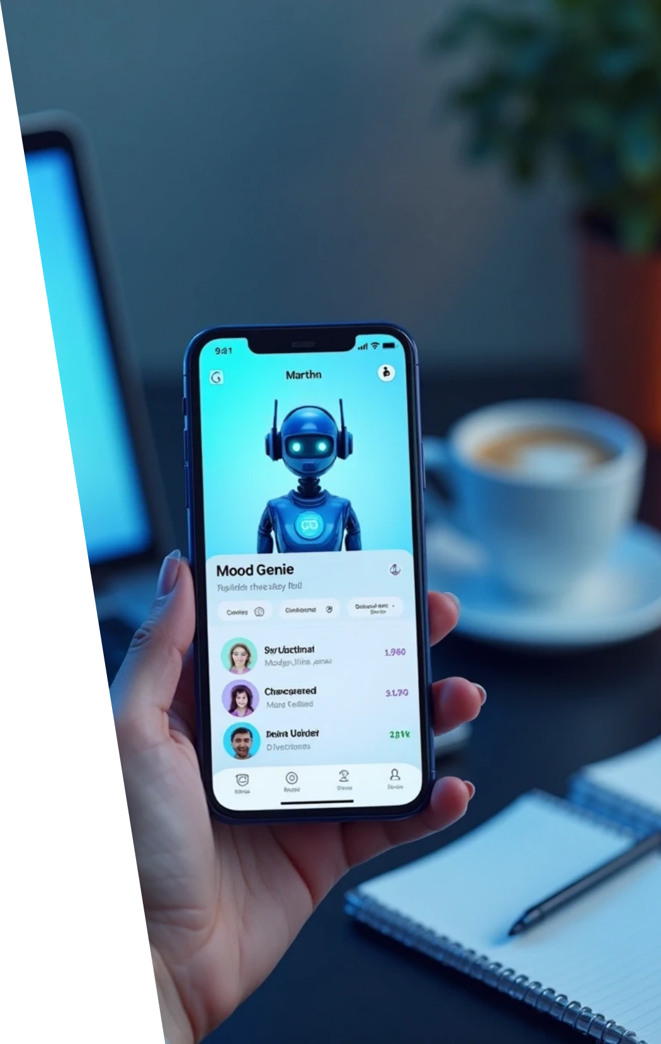
1. Introduction
MoodGenie – AI-Powered Mental Health Support for the Tech Community
MoodGenie is a cross-platform mobile application designed to address stress, burnout, and anxiety among software developers, research scholars, and students. It merges AI-driven self-care, secure therapist sessions, and mood analytics in one platform.
MoodGenie offers an empathetic AI chatbot, licensed therapist access, and weekly mood reports, helping users better manage their emotional well-being.
Built with Flutter, Node.js, Firebase, and OpenAI, it ensures a privacy-first, affordable, and tech-community-focused solution.

Slide 4


2. Problem Statement
The tech community faces high levels of stress, anxiety, and burnout, driven by long working hours, deadlines, and cognitive overload. Despite awareness, traditional mental health support remains inaccessible due to cost, stigma, or lack of personalization. Existing apps like Wysa, Woebot, and Youper provide partial help—either AI-only or therapist-only—leaving a gap for an integrated, affordable, and private solution.
Target Users
Market Potential
Software developers, research students, and scholars.
Over 27 million developers globally, with growing demand for digital mental health tools.

Slide 5
3. Related Work
App | Key Features | Limitations
Wysa | AI chatbot + paid human coach | Limited free version; costly support
Woebot | AI cognitive therapy chatbot | No therapist integration
Youper | AI journaling & assessments | Lacks real therapy sessions
Earkick | AI mood & anxiety tracking | Limited to iOS; no therapist access
MoodGenie fills the gap by integrating AI self-help, therapist sessions, and mood analytics into one hybrid, privacy-first platform tailored for the tech community.

Slide 6
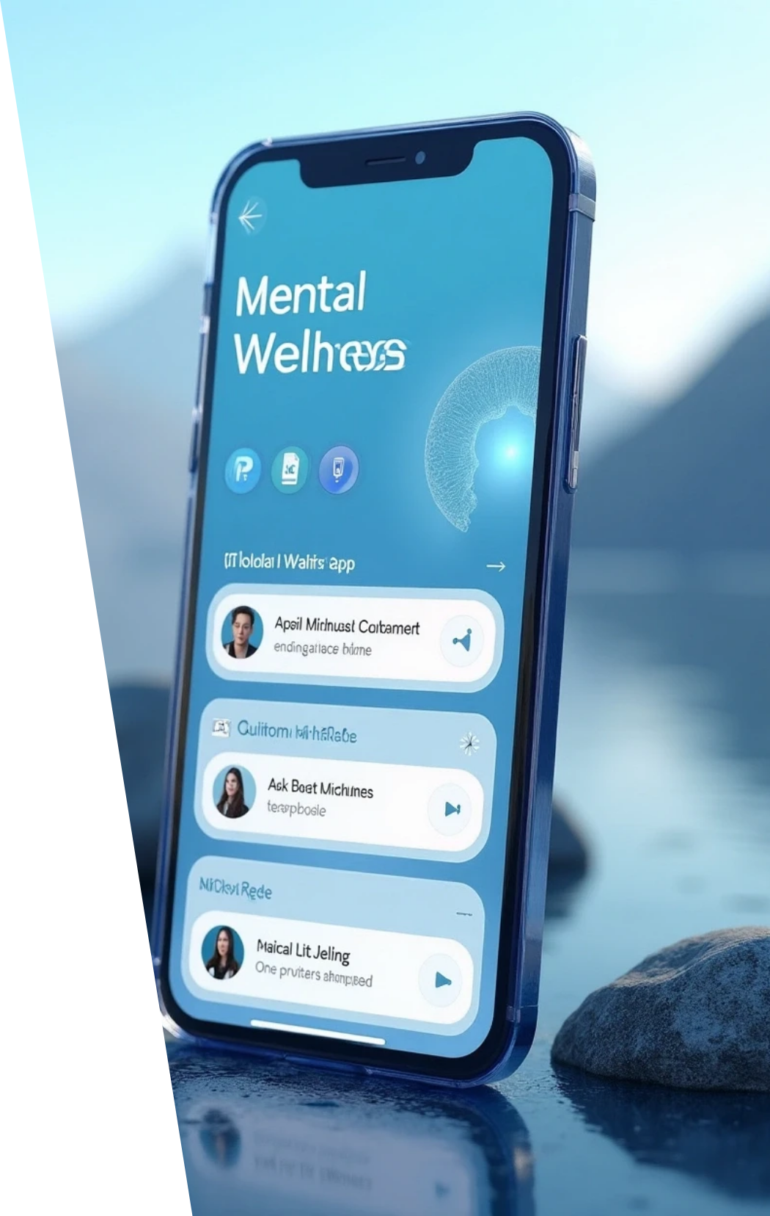

4. Project Scope
Goal:
Develop a hybrid mental wellness app combining AI emotional support, professional therapy, and mood tracking.

Slide 7




Core Features
1
2
Empathetic AI chatbot for mood check-ins.
Secure therapist video/text sessions.
3
4
Mood tracking with weekly/monthly analytics.
Data privacy controls and encryption.

Slide 8
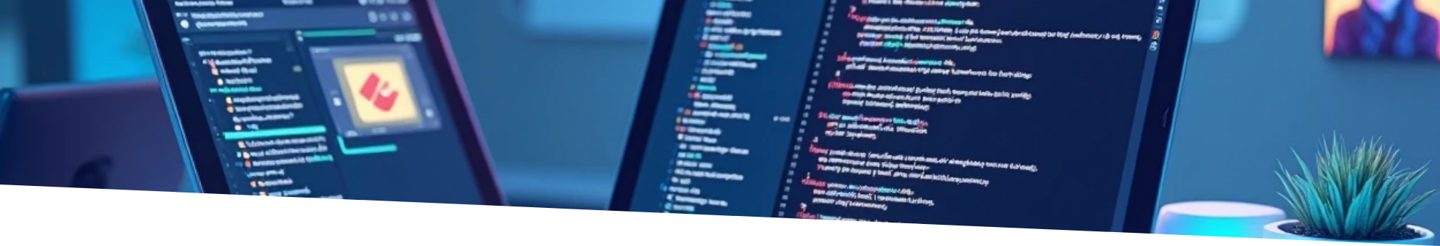
Tools & Technologies
Flutter (Frontend)
Node.js + Express (Backend)
Firebase (Database)
OpenAI/Hugging Face (AI)
WebRTC (Video Sessions)

Slide 9

Value Proposition
Affordable, privacy-focused, and specifically designed for developers and research students.

Slide 10


5. Sustainable Development Goals
MoodGenie aligns with the United Nations SDGs:
Goal 3
Goal 8
Good Health & Well-Being – Promotes accessible mental wellness support through digital innovation.
Decent Work & Economic Growth – Encourages better mental health in the workforce, reducing burnout and improving productivity.

Slide 11


6. Methodology
Approach
Agile methodology with iterative development.

Slide 12


Phases
Requirement gathering & design (Figma, Visual Paradigm)
Core AI & mood tracking development
Therapist booking integration (WebRTC)
Testing, privacy validation, and deployment
Tech Stack
Flutter, Node.js, Express.js, Firebase, OpenAI API, Hugging Face, WebRTC, GitHub, VS Code, Android Studio.
Why Agile?
It allows flexibility, quick iterations, and continuous feedback from test users.

Slide 13
7. Milestones & Deliverables
Milestone | Timeline | Deliverable
Requirement Analysis & Design | Sep – Oct 2025 | App design, database schema
Core AI & Mood Tracking | Nov – Dec 2025 | Functional AI & mood log
Therapist Booking & Sessions | Jan – Feb 2026 | Video/text session integration
Integration & Privacy Features | Mar 2026 | Consent system, encryption setup
Testing & Documentation | Apr 2026 | Final testing, report, and demo

Slide 14

8. External Supervisor
External Supervisor: Mohid Usman
Role: Industry professional providing guidance on AI integration, app architecture, and deployment best practices. Their expertise ensures real-world relevance, technical accuracy, and industry alignment for the project.

Slide 15





9. References
1
2
World Health Organization (2023) – WHO Mental Health Report
Javed, A. et al. (2021) – Reducing stigma of mental disorders in LMICs
3
4
Fitzpatrick, K.K. et al. (2017) – Woebot Cognitive Behavior Therapy Trial
Inkster, B. et al. (2018) – Wysa Evaluation Study
5
6
Topooco, N. et al. (2022) – Digital Interventions in College Mental Health
Chen, K. et al. (2024) – Hybrid Care in Mental Health
7
8
Conrad, J.A. (2024) – Digitization & Limitations of Digital Therapy
Lecourt, F. et al. (2025) – Empirical Analysis of GPT in Emotion Detection

Slide 16

Thank You

